Slide 1
Rclone
Lecturer: Ngo Huy Bien
Software Engineering Department
Faculty of Information Technology
VNUHCM - University of Science
Ho Chi Minh City, Vietnam
nhbien@fit.hcmus.edu.vn

Slide 2

Objectives

Slide 3

Contents

Slide 4

References

Slide 5
Rclone
https://rclone.org/
Rclone is a command-line program to manage files on cloud storage.
Rclone helps you:
Backup (and encrypt) files to cloud storage
Restore (and decrypt) files from cloud storage
Mirror cloud data to other cloud services or locally
https://rclone.org/install/
# Rclone is a Go program and comes as a single binary file.

Slide 6
1. Install Rclone Manually on Ubuntu
curl -O https://downloads.rclone.org/rclone-current-linux-amd64.zip
unzip rclone-current-linux-amd64.zip
cd rclone-*-linux-amd64
sudo cp rclone /usr/bin/
sudo chown root:root /usr/bin/rclone
sudo chmod 755 /usr/bin/rclone
sudo mkdir -p /usr/local/share/man/man1
sudo cp rclone.1 /usr/local/share/man/man1/
sudo mandb
rclone version

Slide 7
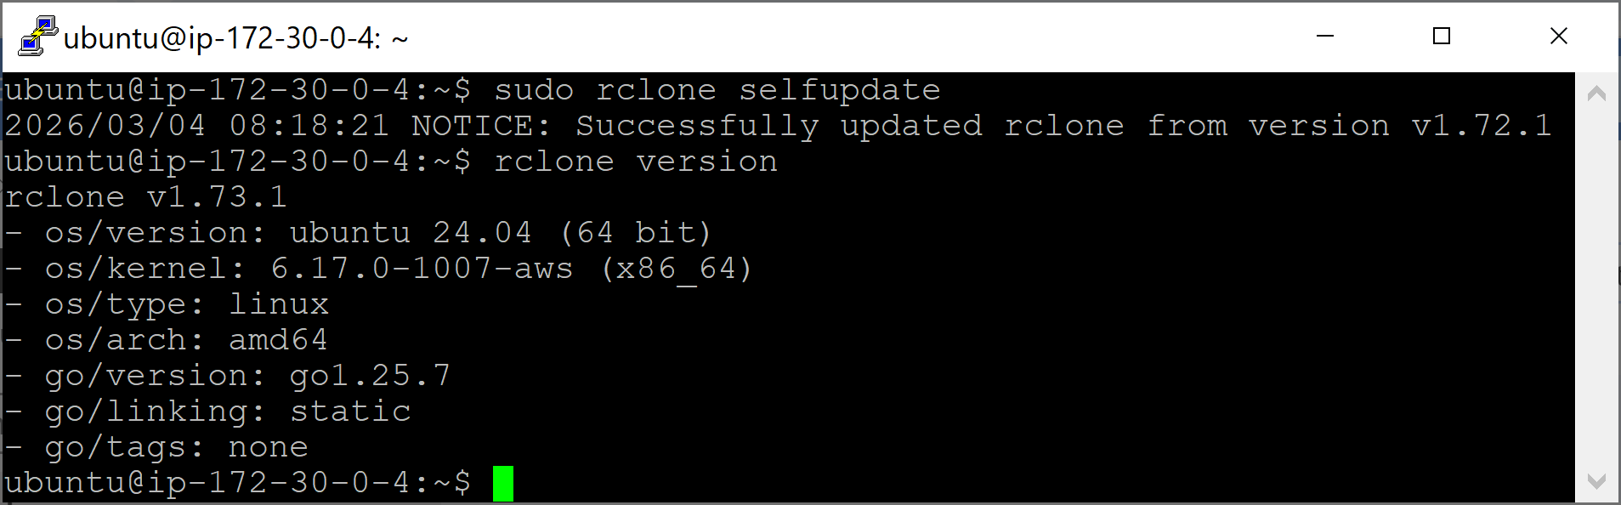
2. Update Rclone
sudo rclone selfupdate
rclone version

Slide 8
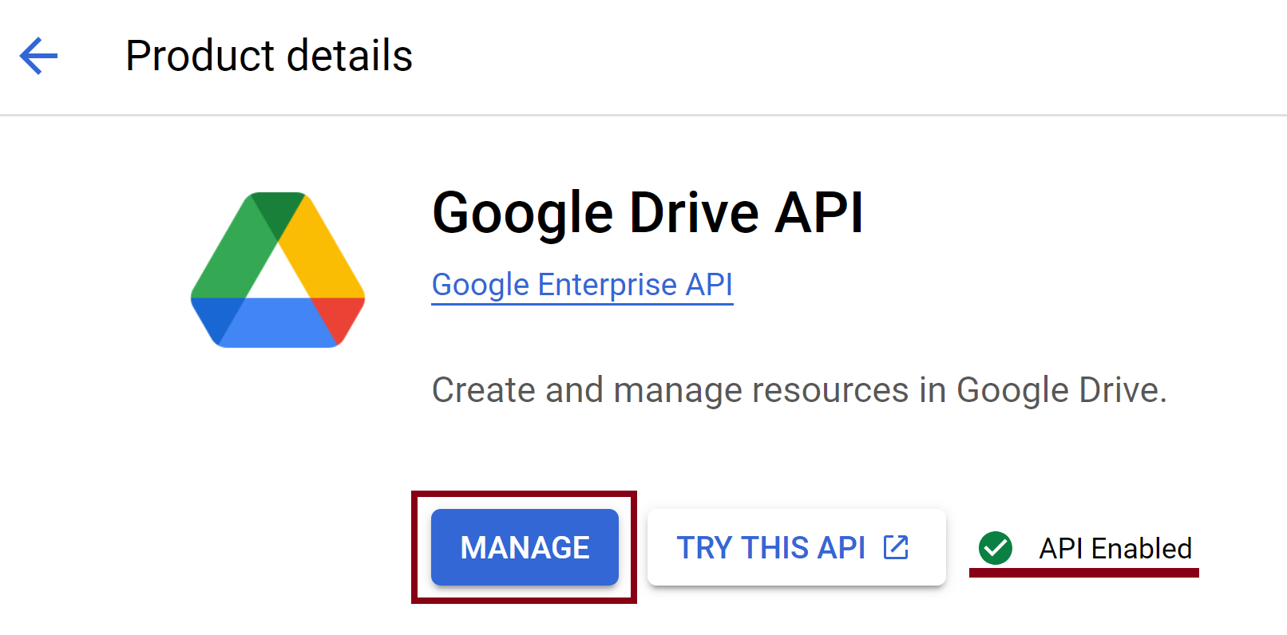
3. Go to Google Drive API
https://console.cloud.google.com
(Any account can be used. It need not be the same account as the Google Drive you want to access)

Slide 9
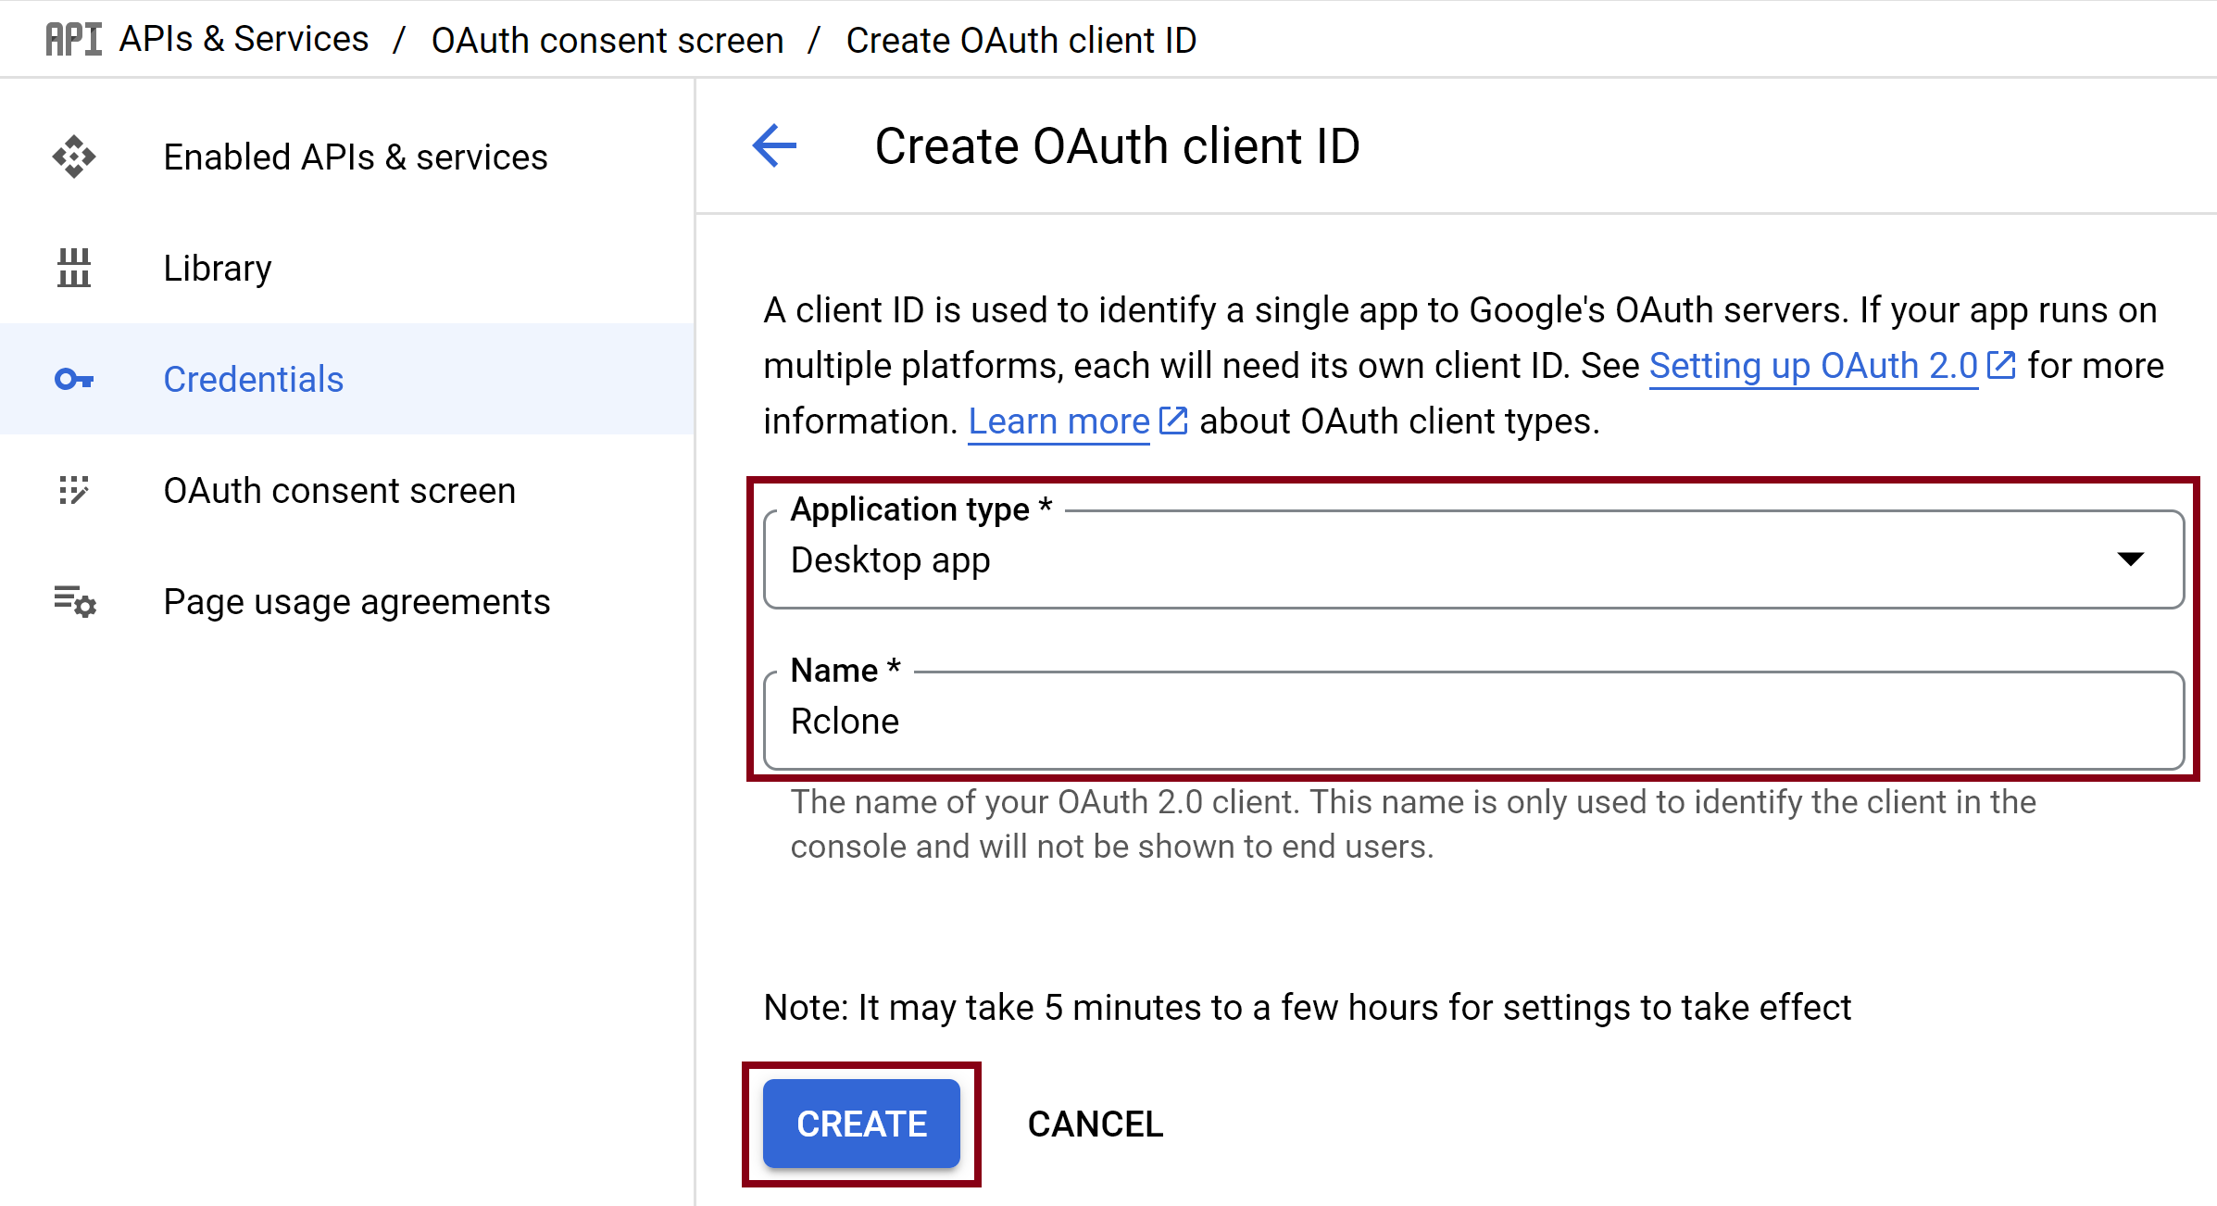
4. Create OAuth client ID

Slide 10
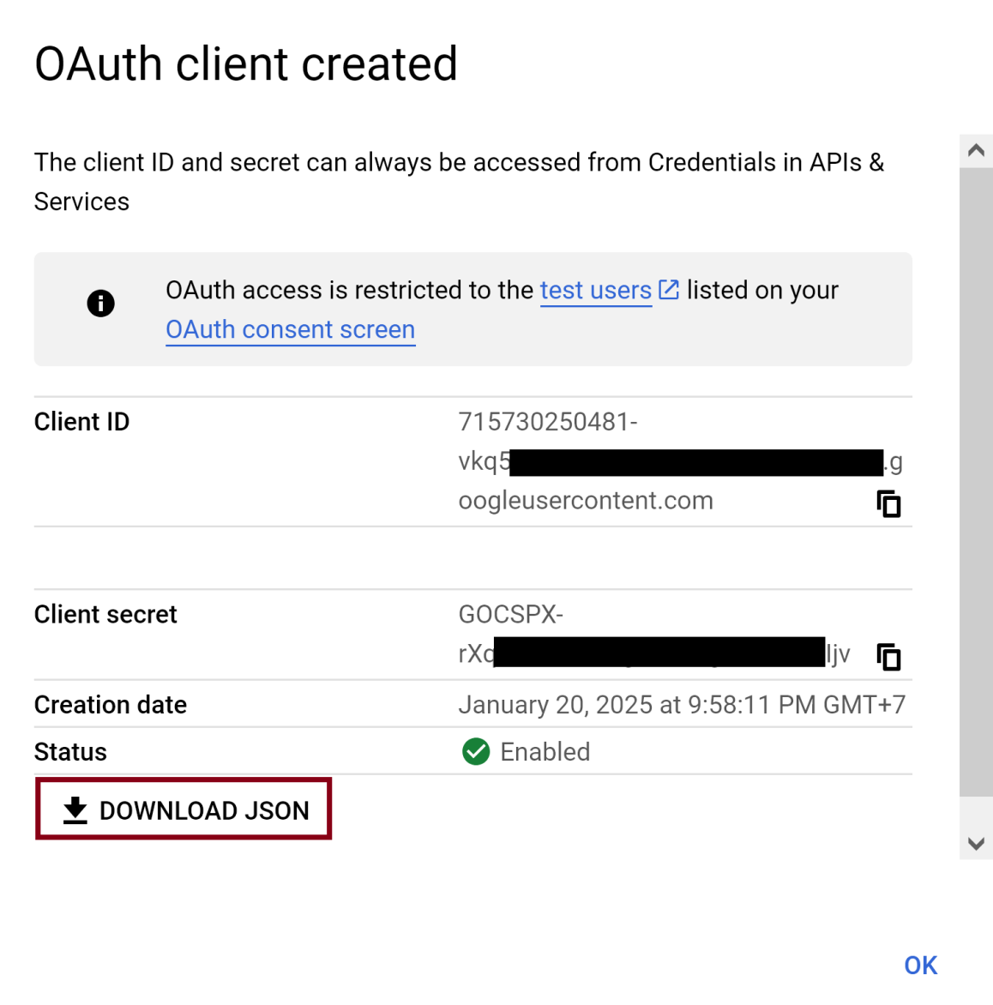
5. Download Credentials

Slide 11
6. Configure Rclone for Google Drive on Ubuntu
rclone config
# Select n, enter "gdrive", select 24
# Select 1/ Full access all files,
# Press Enter for "service_account_file"
# Select n for "Edit advanced config?"
# Select n for "Use web browser..."
# Copy command to retrieve config_token.

Slide 12
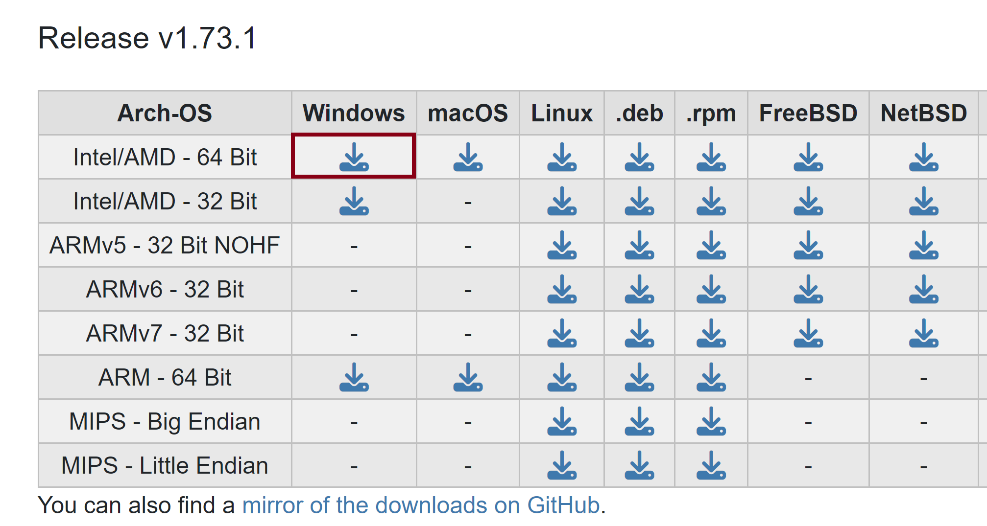
7. Download rclone on Windows
https://rclone.org/downloads/
Select the same rclone version, i.e. 1.73.1

Slide 13
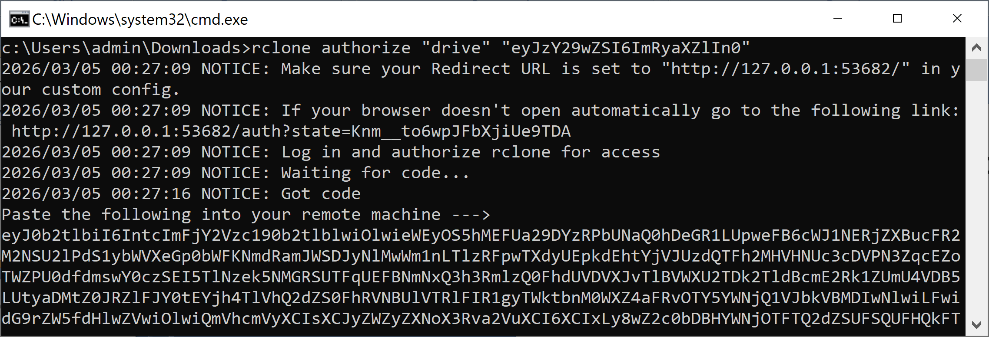
8. Generate Token on Windows
rclone authorize "drive" "eyJzY29wZSI6ImRyaXZlIn0"

Slide 14
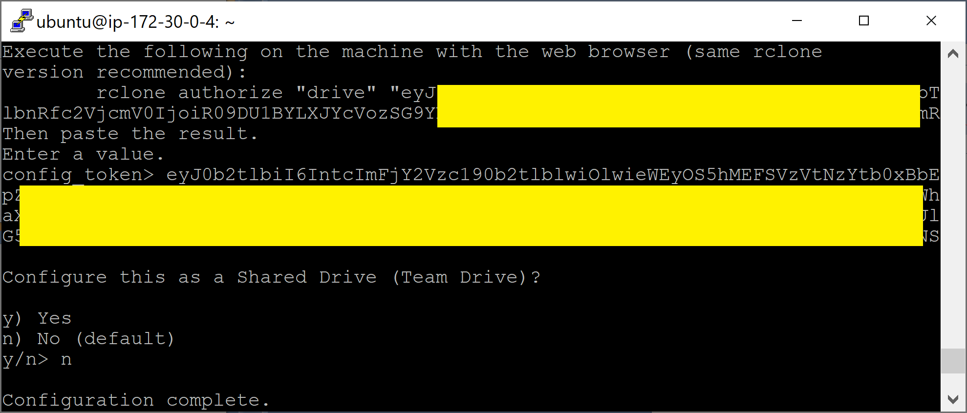
9. Paste config_token

Slide 15
10. Upload File on Ubuntu
rclone lsd gdrive:
ls
rclone copy wp.zip gdrive:rclone --progress
# Upload fails when copying 15Gb file!!!
# Error: your computer or network may be sending automated queries.
rclone copy copg.zip gdrive:rclone --bwlimit 10M --progress

Slide 16
11. Download File on Ubuntu
rclone lsd gdrive:
rclone copy -P gdrive:rclone/wp.zip /home/ubuntu

Slide 17
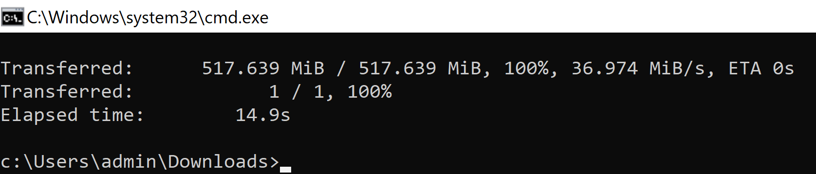
12. Download File on Windows
rclone lsd gdrive:
rclone lsf gdrive:rclone
rclone copy -P gdrive:rclone/codebase.zip ./

Slide 18


Slide 19
1. Configure Rclone for One Drive
https://rclone.org/onedrive/
rclone config
# Select n, enter "odrive", select 41
# Leave client_id and client_secret empty.
# Select 1/ Microsoft Cloud Global,
# Leave tenant empty.
# Select n for "Edit advanced config?"
# Select n for "Use web browser..."
# Copy command to retrieve config_token.

Slide 20
2. Download rclone on Windows
https://rclone.org/downloads/
Select the same rclone version, i.e. 1.73.1

Slide 21
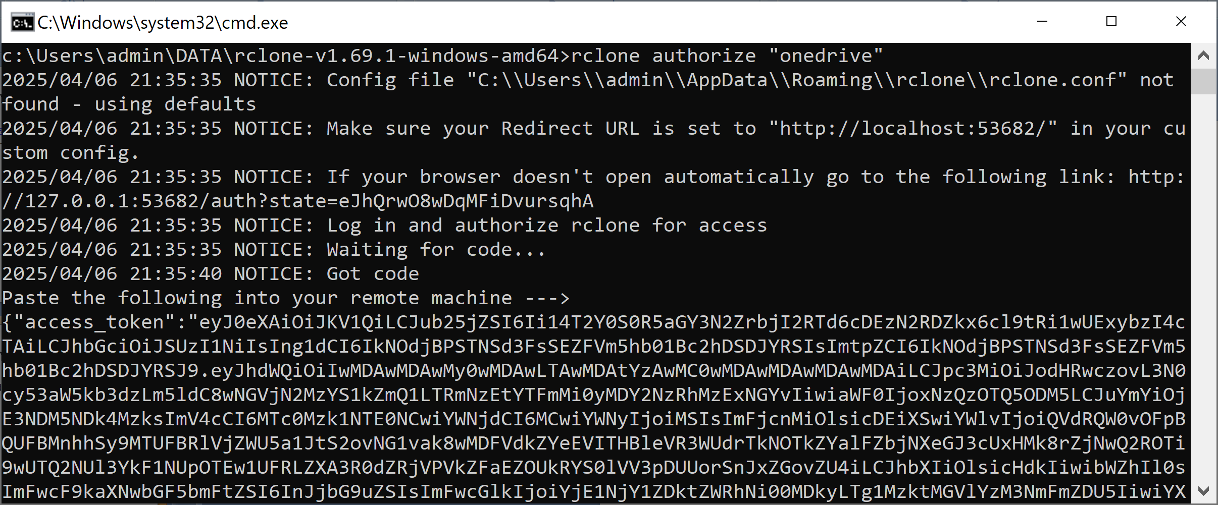
3. Generate Token on Windows
rclone authorize "onedrive"

Slide 22
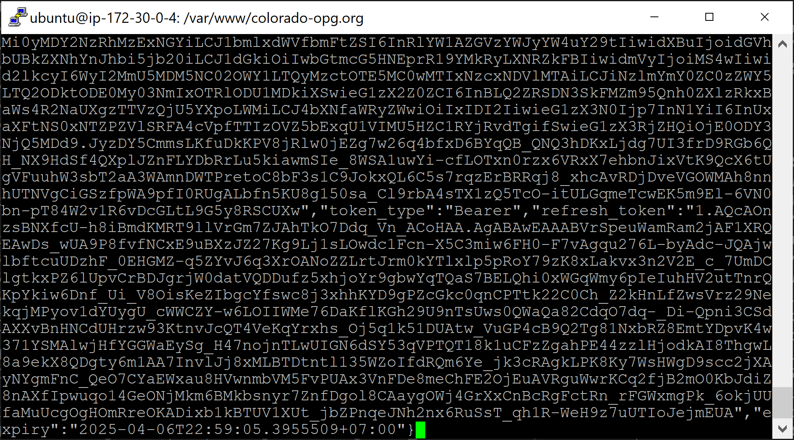
4. Paste config_token on Ubuntu

Slide 23
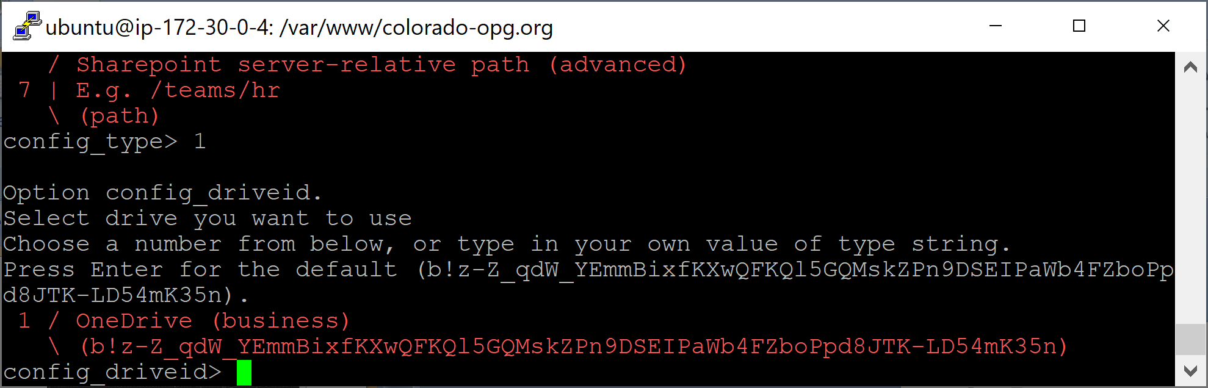
5. Complete Configuration Process
# Select 1 for config_type
# Select default for everything else.

Slide 24
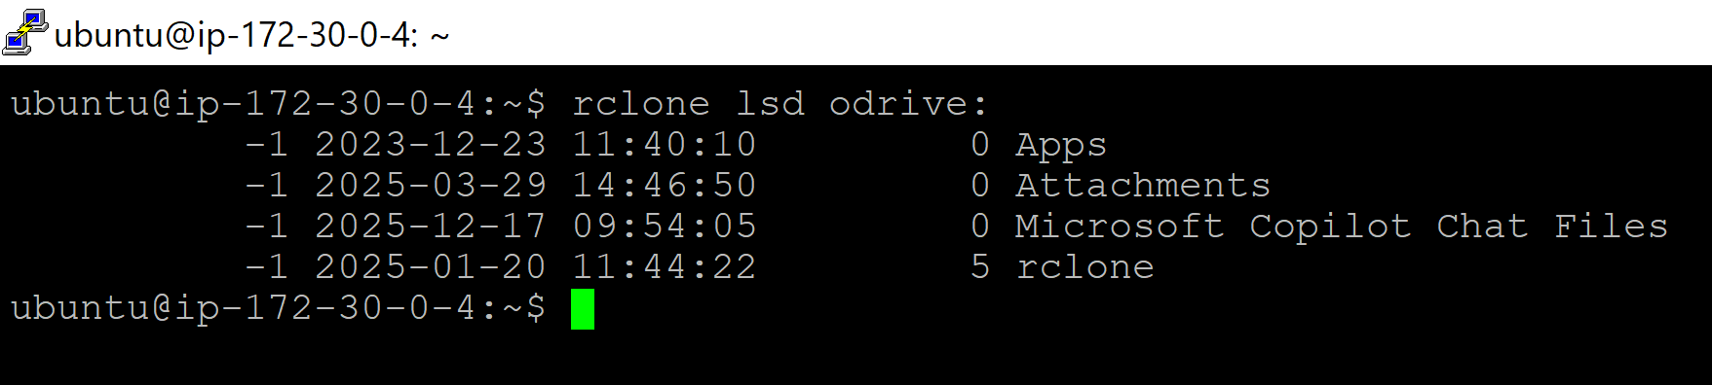
6. Upload File on Ubuntu
rclone lsd odrive:
ls
rclone copy wp.zip odrive:rclone --progress

Slide 25
7. Download File to Ubuntu Server
rclone lsd odrive:
rclone copy -P odrive:rclone/wp.zip /home/ubuntu

Slide 26
8. Download File to Windows
rclone lsd odrive:
rclone copy -P odrive:rclone/db_2025-12-19.zip ./

Slide 27
9. Refresh Token
Delete the existing remote storage, then create a new one.

Slide 28

Thank You & See You Again

